Slide 1
Lecture 7: Neural Networks;

Slide 2
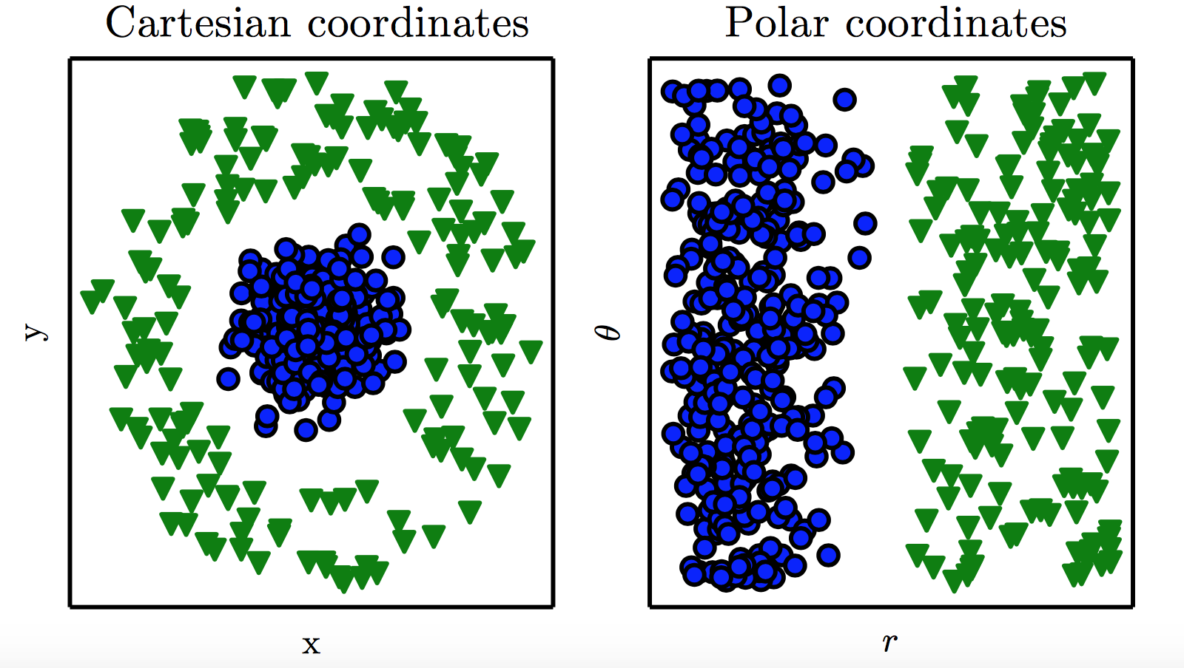
Representation
Representation Matters

Slide 3
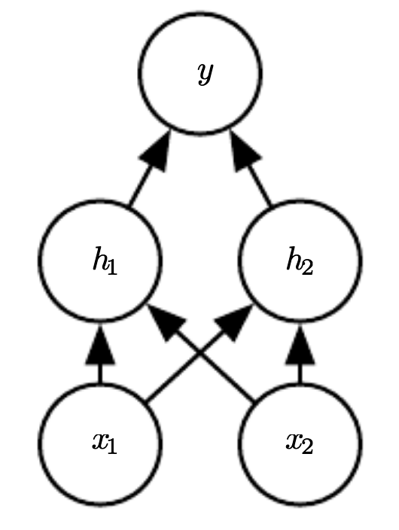
Neural Network

Slide 4
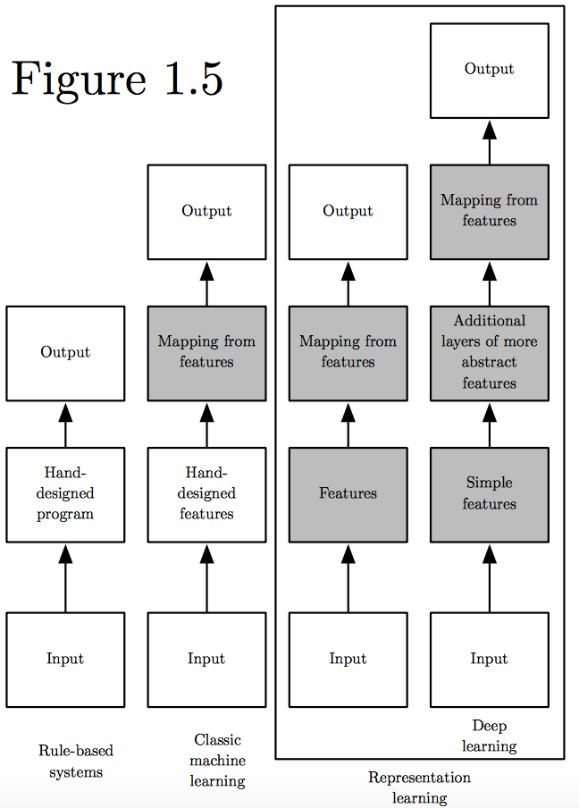
Learning Multiple Components
(Goodfellow 2016)

Slide 5
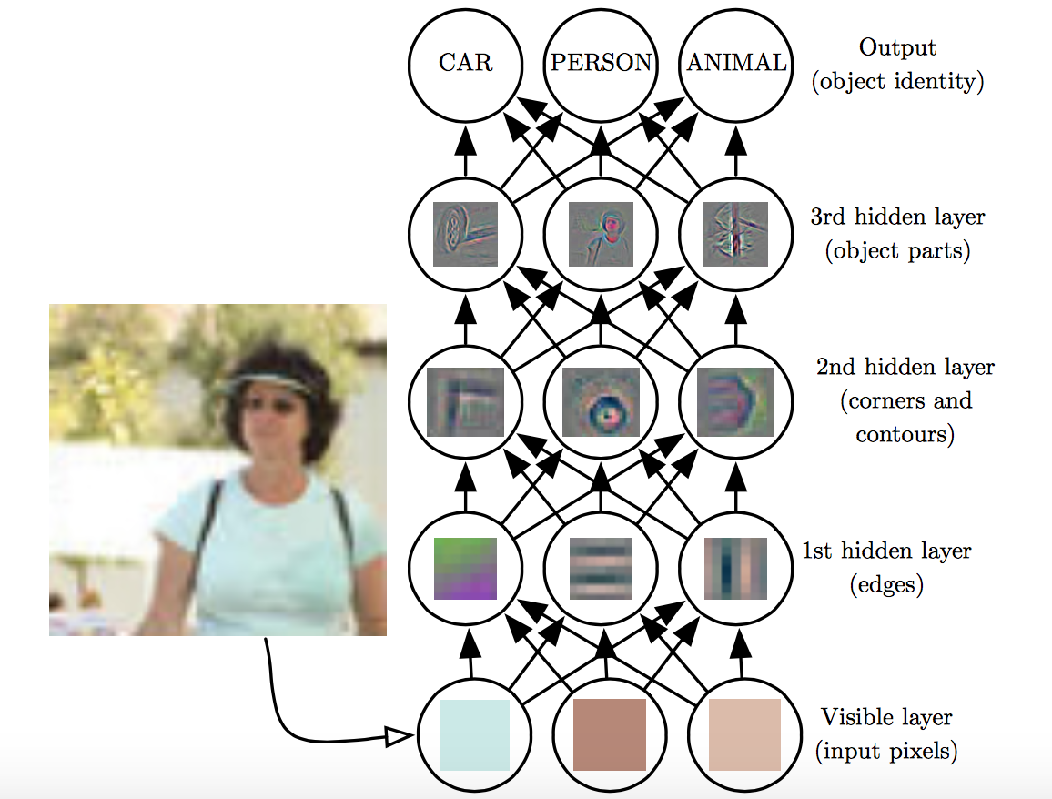
Depth = Repeated Compositions

Slide 6
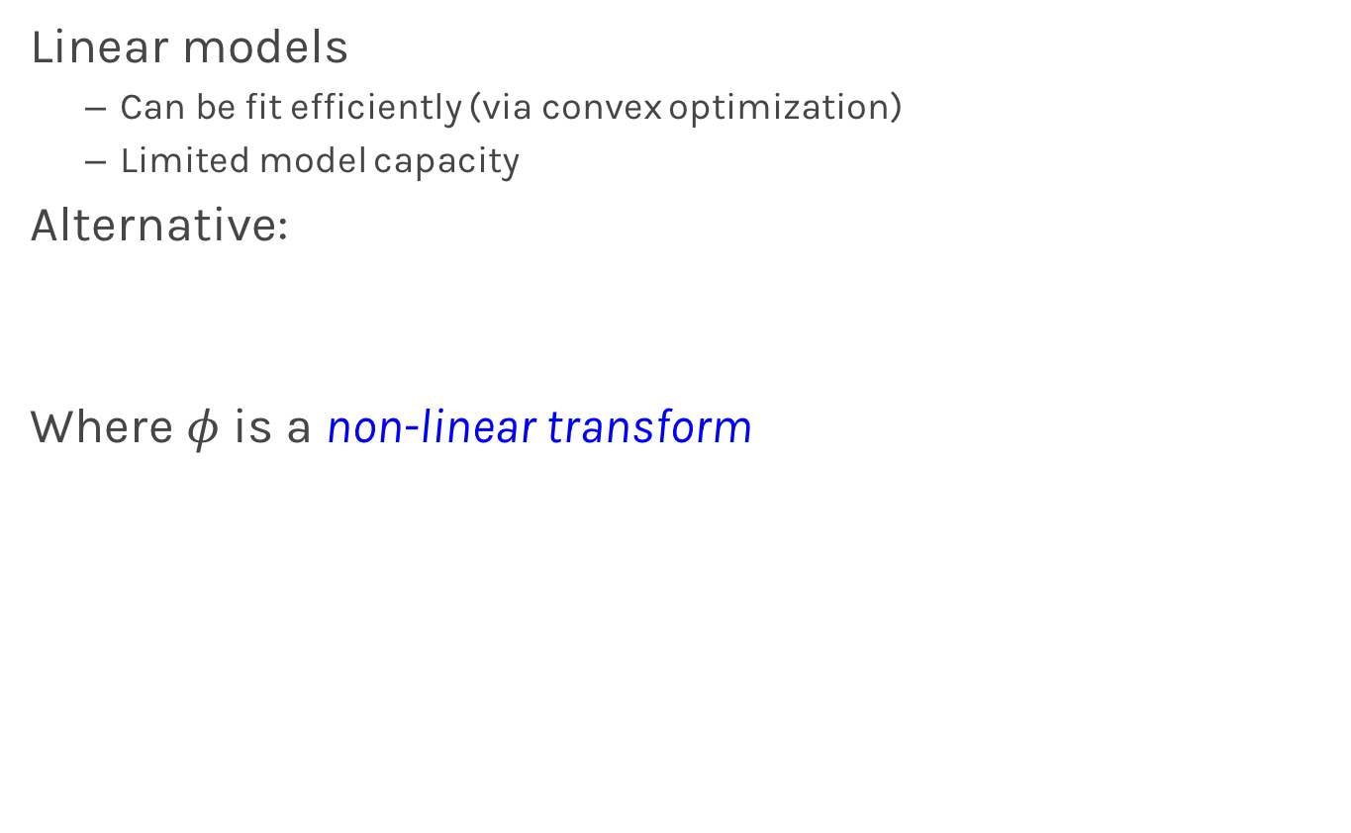
Beyond Linear Models
Linear models
Can be fit efficiently (via convex optimization)
Limited model capacity
Alternative:
Where $φ$ is a non-linear transform

Slide 7
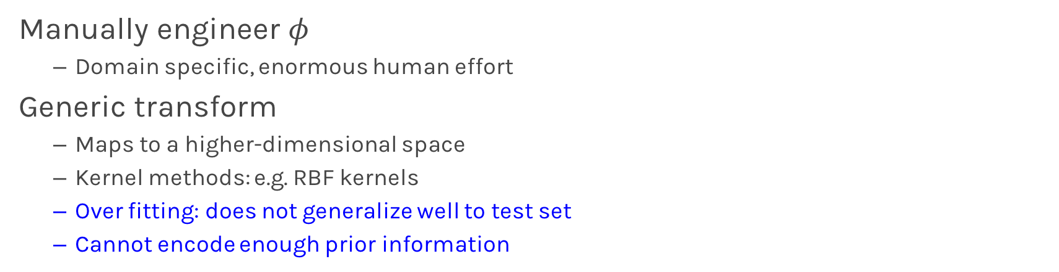
Traditional ML
Manually engineer $φ$
Domain specific, enormous human effort
Generic transform
Maps to a higher-dimensional space
Kernel methods: e.g. RBF kernels
Over fitting: does not generalize well to test set
Cannot encode enough prior information

Slide 8
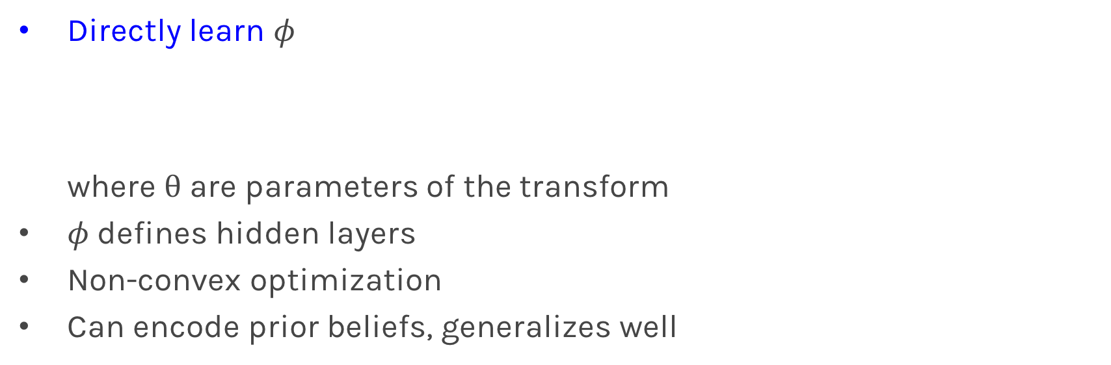
Deep Learning
Directly learn $φ$ where $θ$ are parameters of the transform
$φ$defines hidden layers
Non-convex optimization
Can encode prior beliefs, generalizes well

Slide 9
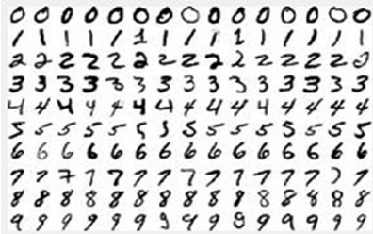
Neural Networks
Hand-written digit recognition: MNIST data

Slide 10
Example: Learning XOR
where,

Slide 11
Design Choices
Cost function
Output units
Hidden units
Architecture
Optimizer

Slide 12
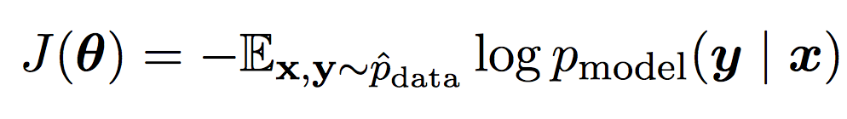
Cost Function
Cross-entropy between training data and model distribution (i.e. negative log-likelihood)
Do not need to design separate cost functions
Gradient of cost function must be large enough

Slide 13
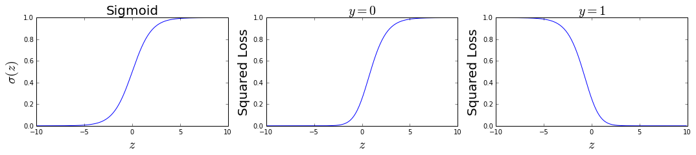
Cost Function
Example: sigmoid output + squared loss
Flat surfaces

Slide 14
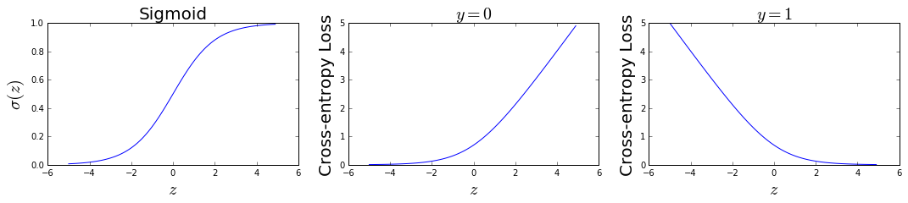
Cost Function
Example: sigmoid output + cross-entropy loss
log undoes exp
Saturates only when the model makes correct predictions

Slide 15
Design Choices
Cost function
Output units
Hidden units
Architecture
Optimizer

Slide 16
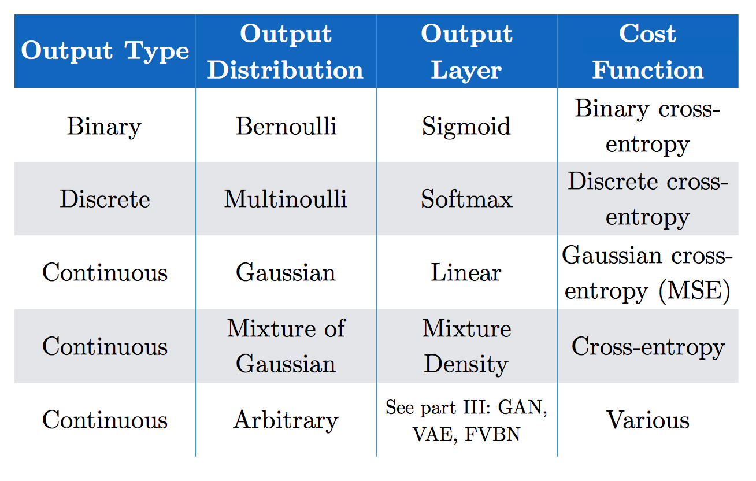
Output Units
(Goodfellow 2017)

Slide 17
Softmax Output
Discrete / Multinoulli output distribution
For output scores z₁, …, z_{n}
Log-likelihood undoes exp

Slide 18
Design Choices
Cost function
Output units
Hidden units
Architecture
Optimizer

Slide 19
Hidden Units
with activation function g
Ensure gradients remain large through hidden unit
Preferred: piece-wise linear activation
Avoid sigmoid/tanh activation
Do not provide useful gradient info when they saturate

Slide 20
ReLU
Rectified Linear Units
Gradient is 1 whenever unit is active
More useful for learning compared to sigmoid
No useful gradient information when z<0
0

Slide 21
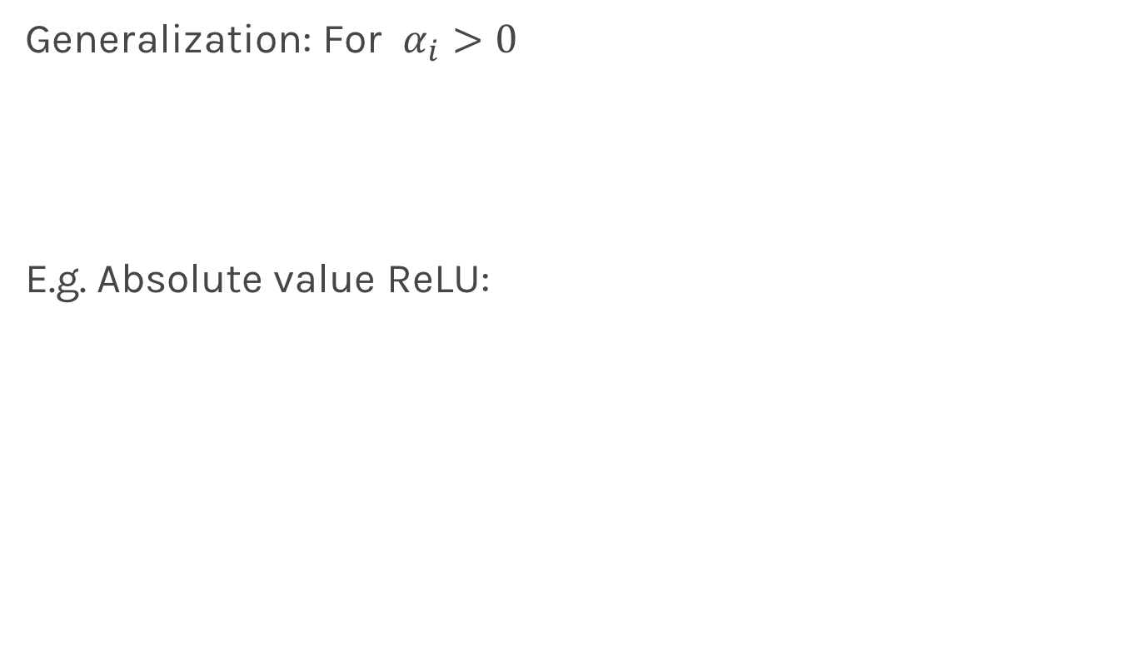
Generalized ReLU
Generalization: For $α_{i}>0$
E.g. Absolute value ReLU:
0

Slide 22
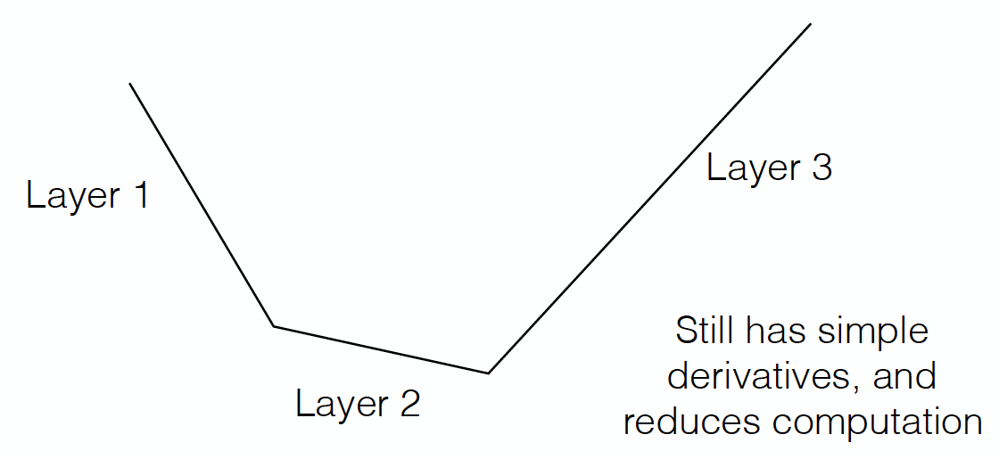
Maxout
Directly learn the activation function
Max of k linear functions
(α₁, β₁)
(α₃, β₃)
Line 3
(α₂, β₂)

Slide 23
Design Choices
Cost function
Output units
Hidden units
Architecture
Optimizer

Slide 24
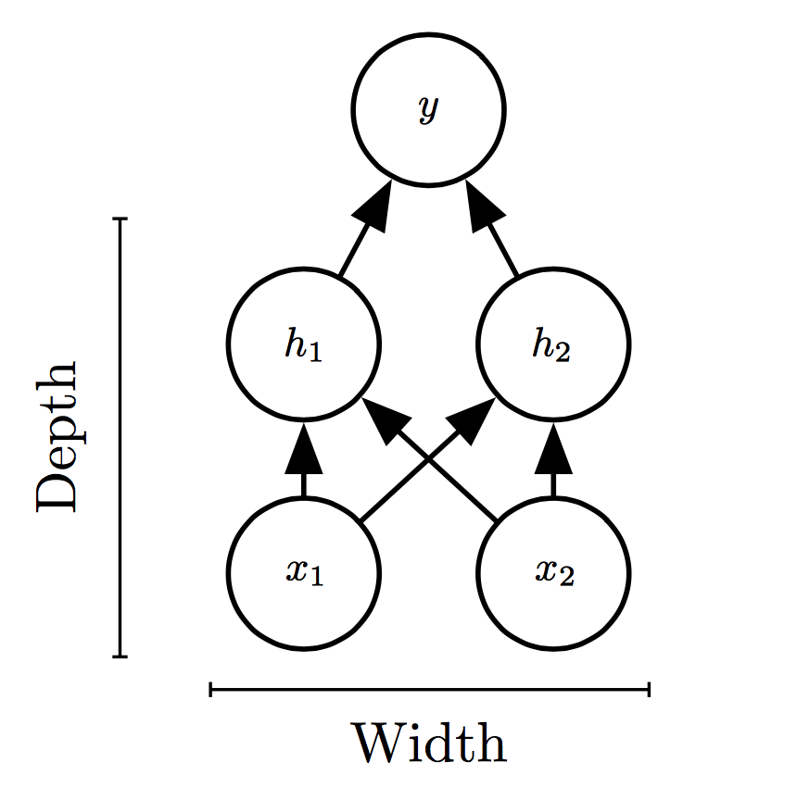
Universal Approximation Theorem
One hidden layer is enough to represent an approximation of any function to an arbitrary degree of accuracy
So why deeper?
Shallow net may need (exponentially) more width
Shallow net may overfit more

Slide 25
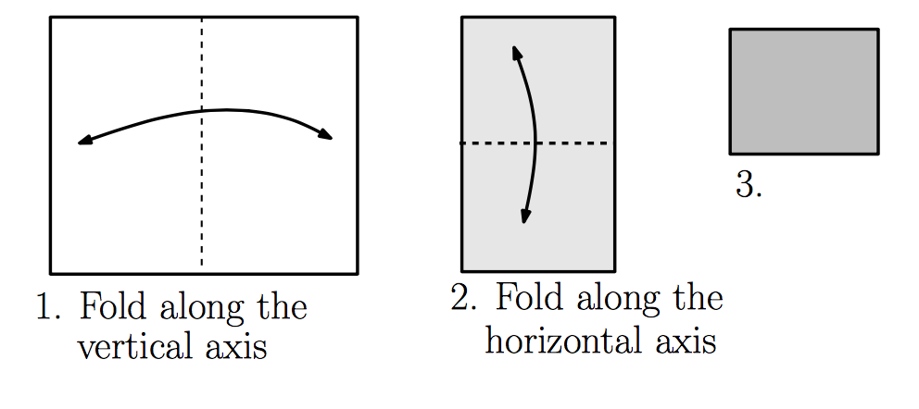
Exponential Gain with Depth
Each hidden layer folds the space of activations of the previous layer. E.g. abs activation
Montúfar (2014)

Slide 26
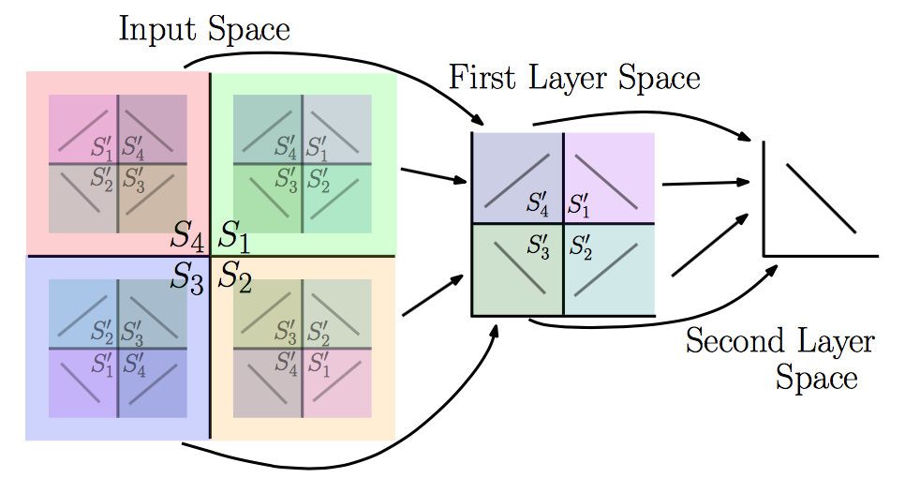
Exponential Gain with Depth
With N hidden layers, there are O(4^{N}) piecewise linear regions
Montúfar (2014)
See illustration in notebook

Slide 27
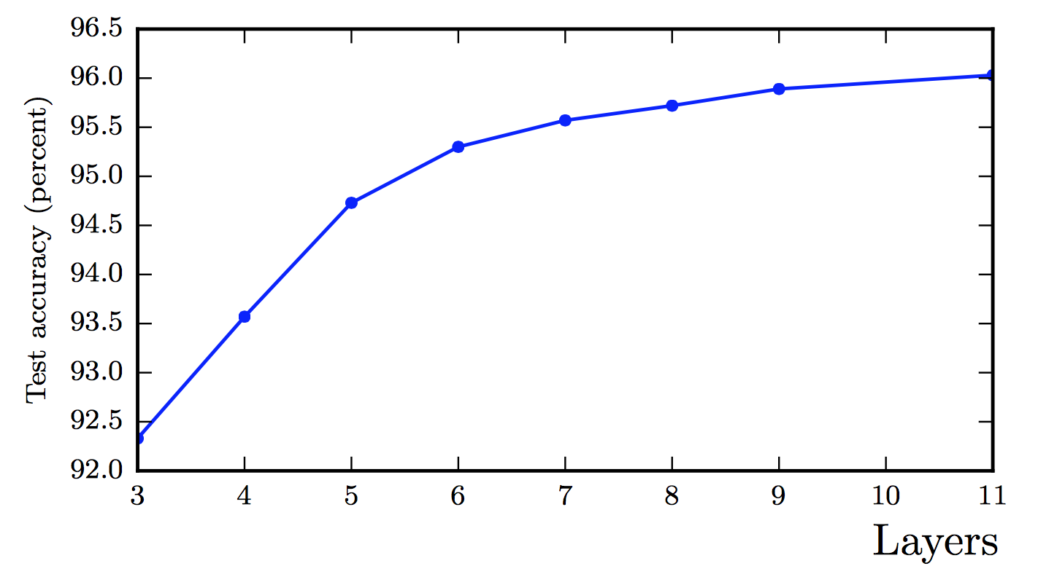
Better Generalization with Depth
(Goodfellow 2017)

Slide 28
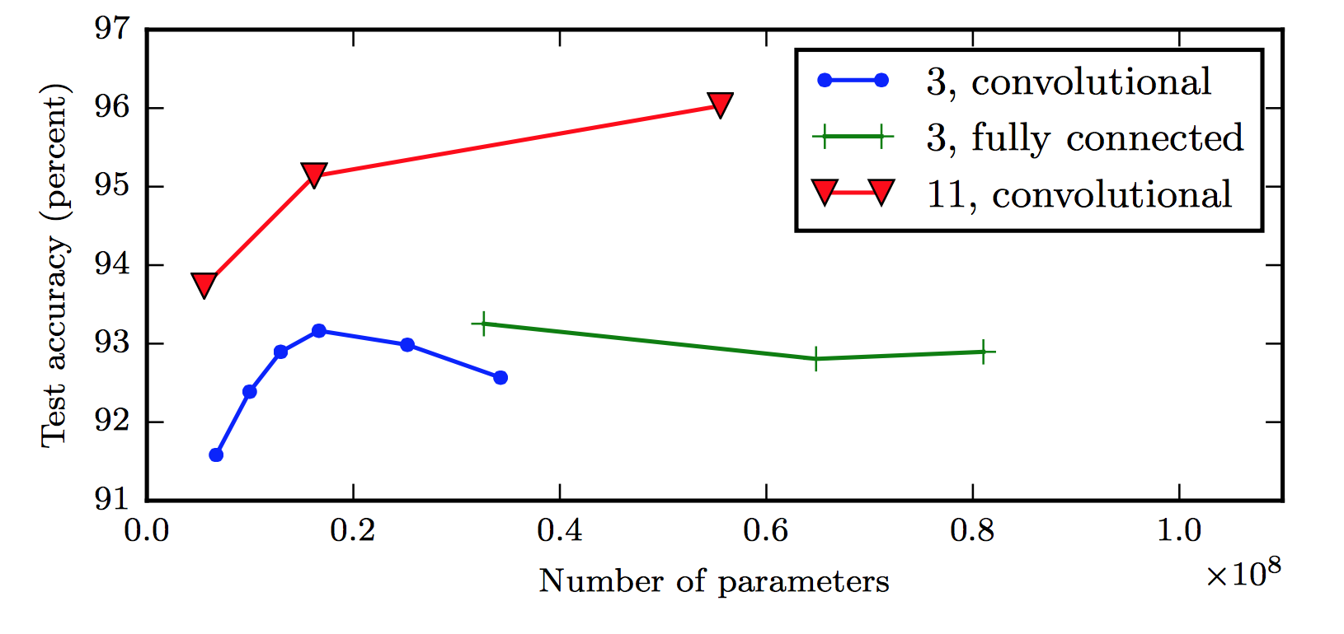
Large, Shallow Nets Overfit More
(Goodfellow 2017)

Slide 29
Design Choices
Cost function
Output units
Hidden units
Architecture
Optimizer

Slide 30
Gradient-based Optimizer (e.g. stochastic gradient descent)
“Chain rule” for computing gradients:
For deeper networks
Naïve computation takes exponential time

Slide 31
Backpropagation
Avoids repeated sub-expressions
Uses dynamic programming (table filling)
Trades-off memory for speed

Slide 32
Backprop: Arithmetic
Jacobian-gradient products
grad w.r.t. x
Jacobian of ‘g’
grad w.r.t. z
Apply recursively!

Slide 33
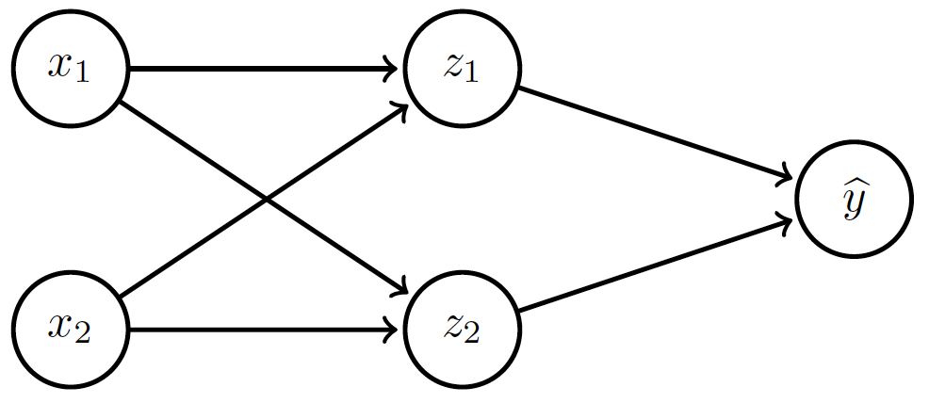
Backprop: Overview
Forward prop: compute activations
Compute loss
Back-prop: compute derivatives

Slide 34
Backprop: Example
Linear activation functions
No bias
Squared loss

Slide 35
Backprop: Example
Forward prop: Propagate activations to output layer

Slide 36
Backprop: Example
Backward prop: Compute loss and its derivative

Slide 37
Backprop: Example
Backward prop: Compute derivatives w.r.t. weights c₁ and c₂

Slide 38
Backprop: Example
Backward prop: Compute derivatives w.r.t. weights c₁ and c₂

Slide 39
Backprop: Example
Backward prop: Propagate derivative to hidden layer

Slide 40
Backprop: Example
Backward prop: Compute derivatives w.r.t. weights a₁, a₂, b₁ and b₂

Slide 41
Backprop: Example
Backward prop: Compute derivatives w.r.t. weights a₁, a₂, b₁ and b₂

Slide 42
Backprop: Example

Slide 43
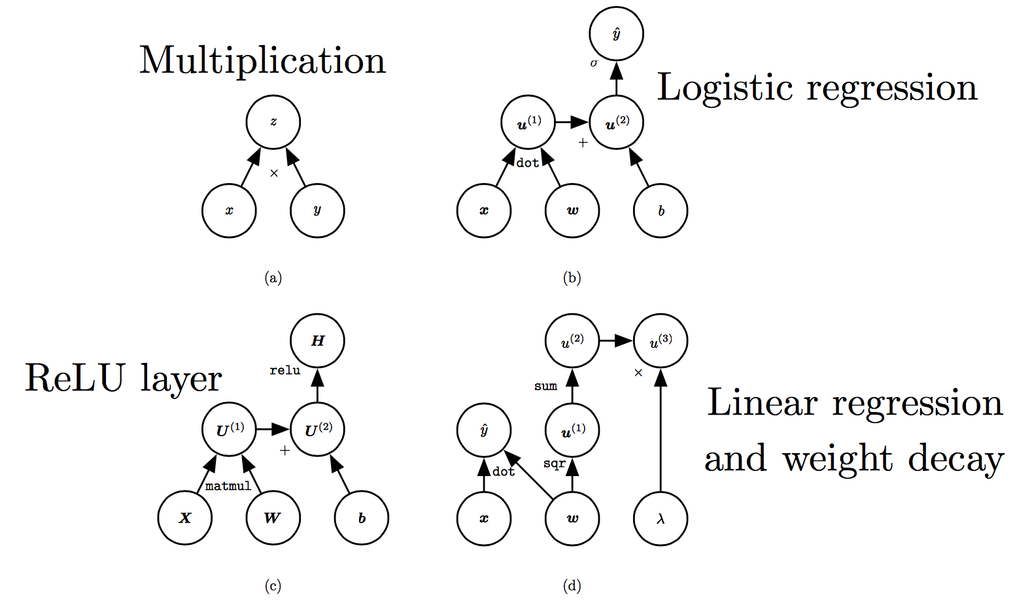
Computation Graphs
(Goodfellow 2017)

Slide 44
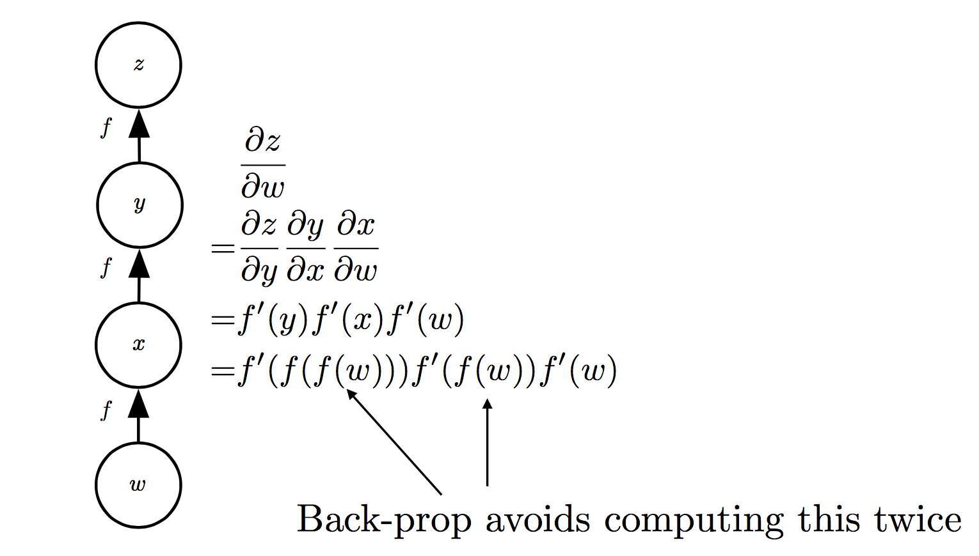
Repeated Sub-expressions
(Goodfellow 2017)

Slide 45
Backprop on Computation Graph
Maintain grad table
Parents of u^{i}

Slide 46
Symbol-to-symbol Differentiation
Derivatives as computation graphs
Same language for both forward and back-propagation
During execution, replace symbolic inputs with numeric value
Used by Theano and TensorFlow
Symbol-to-number differentiation: e.g. Torch and Caffe

Slide 47
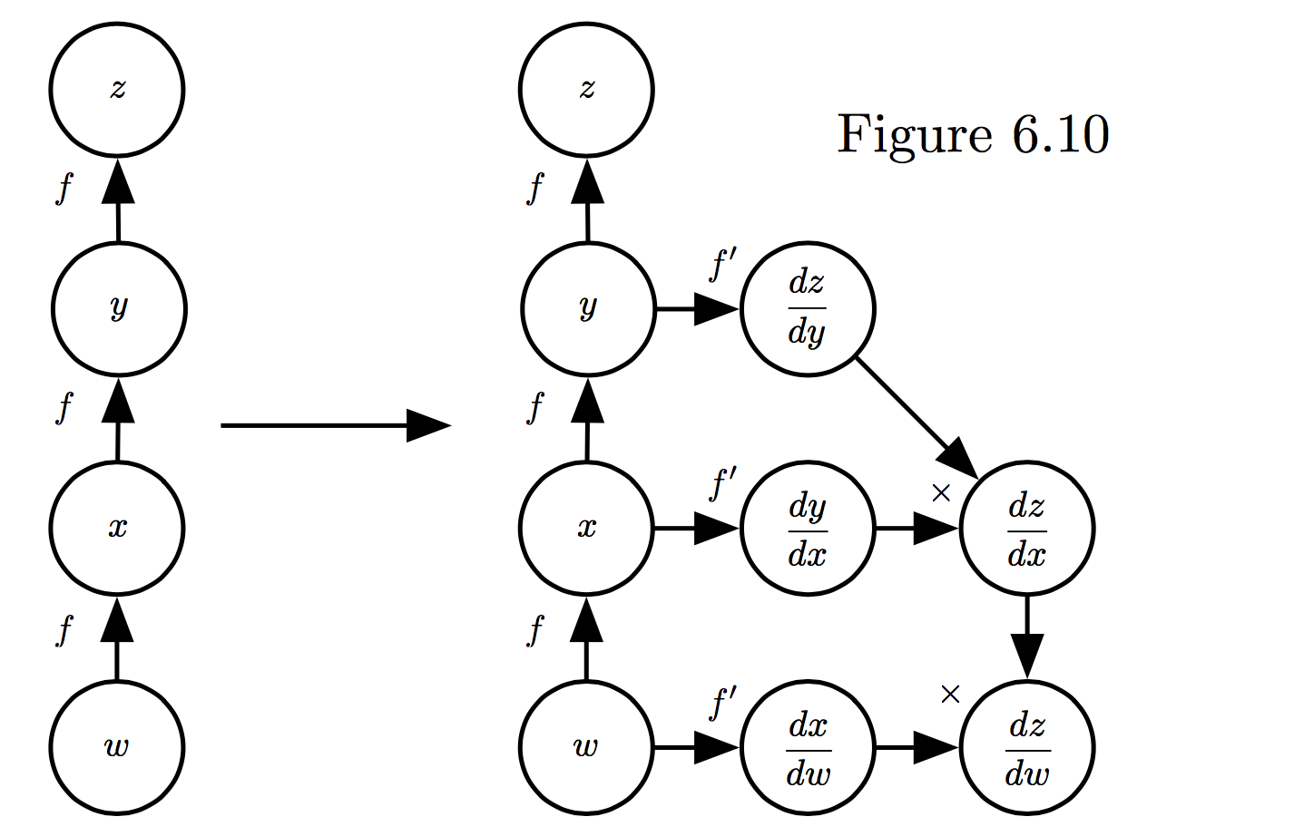
Symbol-to-symbol Differentiation
(Goodfellow et al. 2017)

Slide 48
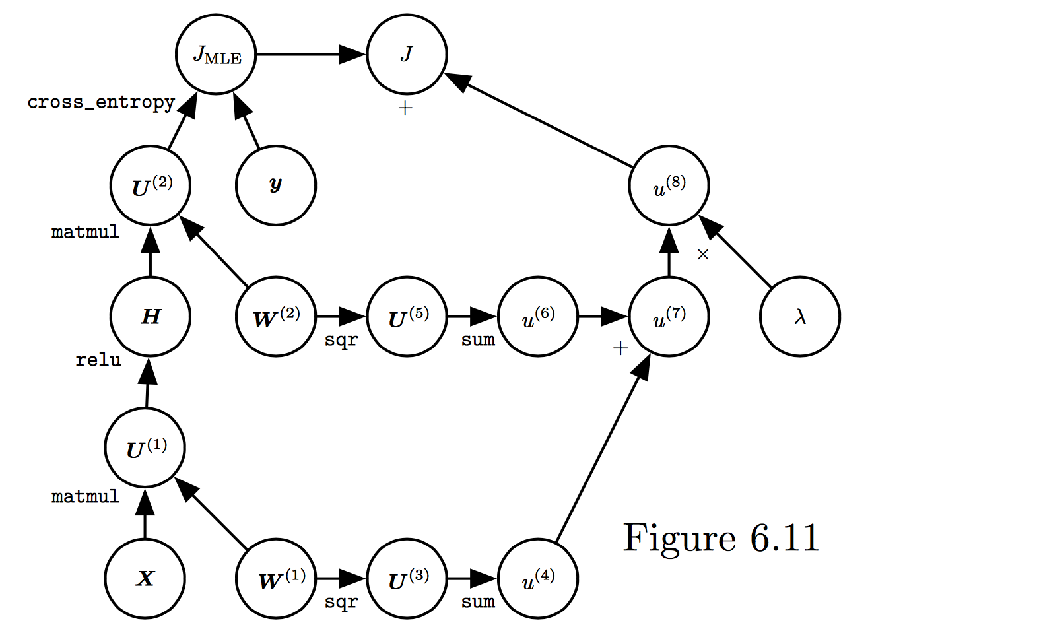
Training Feed-forward Nets
Computational cost for forward/back prop: O(#num-weights)
Memory cost:
O(#num-layers x minibatch-size)
(Goodfellow et al. 2017)

Slide 49
Regularization

Slide 50
Regularization is any modification we make to a learning algorithm that is intended to reduce its generalization error but not its training error

Slide 51
Outline
Norm Penalties
Early Stopping
Data Augmentation
Bagging
Dropout

Slide 52
Outline
Norm Penalties
Early Stopping
Data Augmentation
Bagging
Dropout

Slide 53
Norm Penalties
Optimize:
L₂ regularization:
decays weights
MAP estimation with Gaussian prior
L₁ regularization:
encourages sparsity
MAP estimation with Laplacian prior
Biases not penalized

Slide 54
Norm Penalties as Constraints
Useful if K is known in advance
Optimization:
Construct Lagrangian and apply gradient descent
Projected gradient descent

Slide 55
Outline
Norm Penalties
Early Stopping
Data Augmentation
Bagging
Dropout

Slide 56
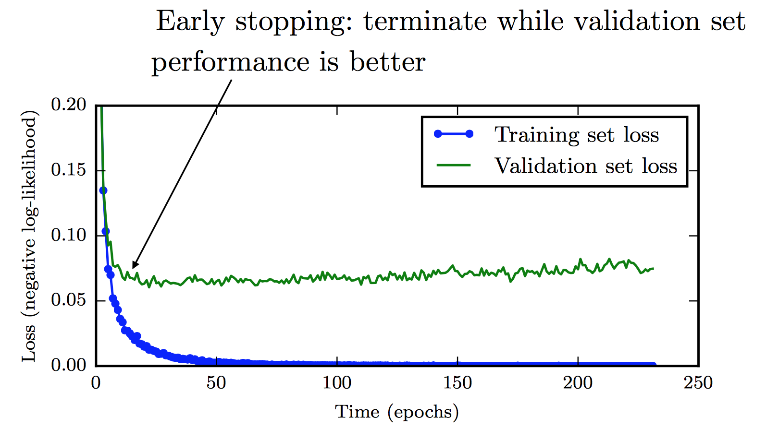
Early Stopping
Training time can be treated as a hyperparameter

Slide 57
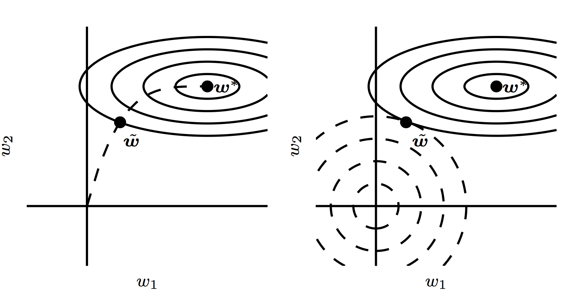
Early Stopping

Slide 58
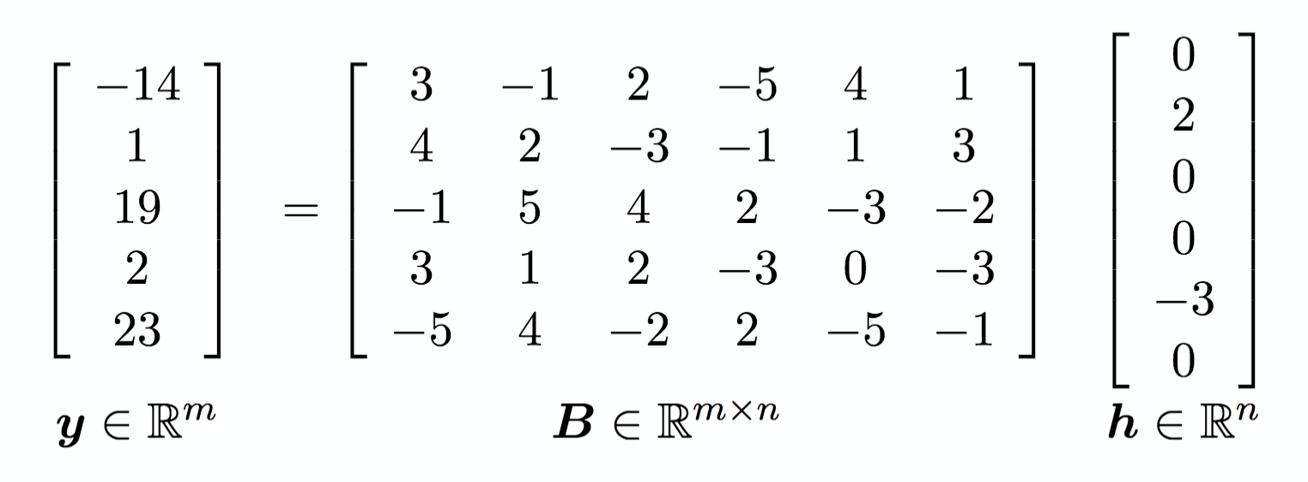
Sparse Representations
Weight decay on activations instead of parameters
Output of hidden layer
Weights in output layer

Slide 59
Outline
Norm Penalties
Early Stopping
Data Augmentation
Bagging
Dropout

Slide 60
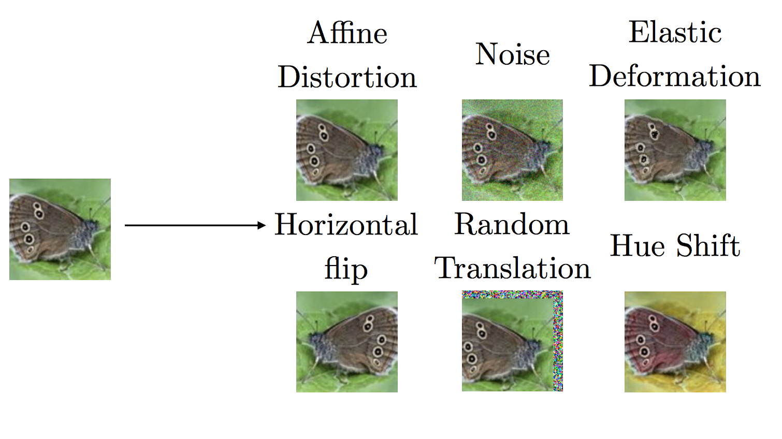
Data Augmentation

Slide 61
Outline
Norm Penalties
Early Stopping
Data Augmentation
Bagging
Dropout

Slide 62
Noise Robustness
Random perturbation of network weights
Gaussian noise: Equivalent to minimizing loss with regularization term
Encourages smooth function: small perturbation in weights leads to small changes in output
Injecting noise in output labels
Better convergence: prevents pursuit of hard probabilities

Slide 63
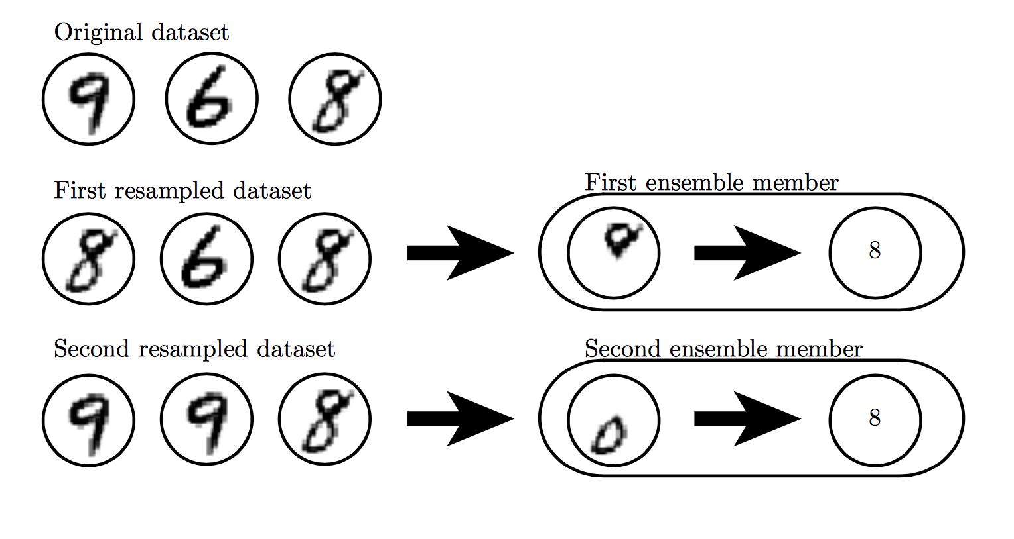
Bagging

Slide 64
Outline
Norm Penalties
Early Stopping
Data Augmentation
Bagging
Dropout

Slide 65
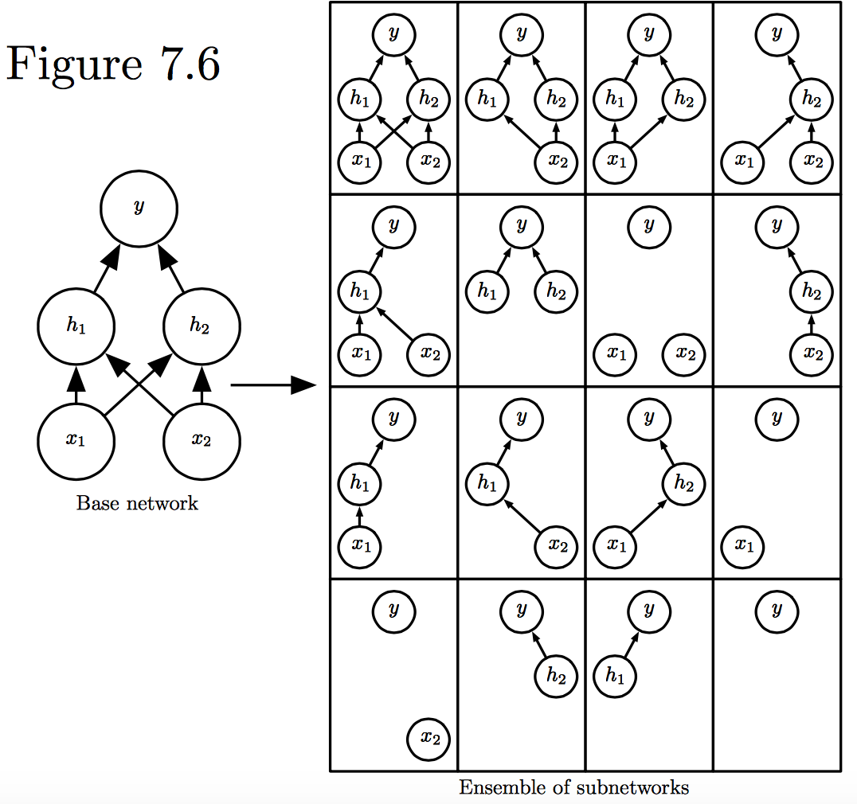
Dropout
Train all sub-networks obtained by removing non-output units from base network

Slide 66
Dropout: Stochastic GD
For each new example/mini-batch:
Randomly sample a binary mask μ independently, where μ_{i} indicates if input/hidden node i is included
Multiply output of node i with μ_{i}, and perform gradient update
Typically, an input node is included with prob=0.8, hidden node with prob=0.5

Slide 67
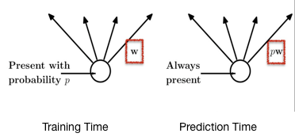
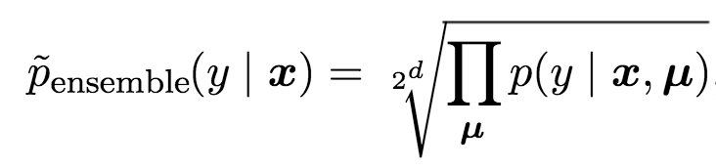
Dropout: Weight Scaling
During prediction time use all units, but scale weights with probability of inclusion
Approximates the following inference rule:
Cristina Scheau (2016)
Notes:
https://chatbotslife.com/regularization-in-deep-learning-f649a45d6e0

Slide 68
Adversarial Examples

Slide 69
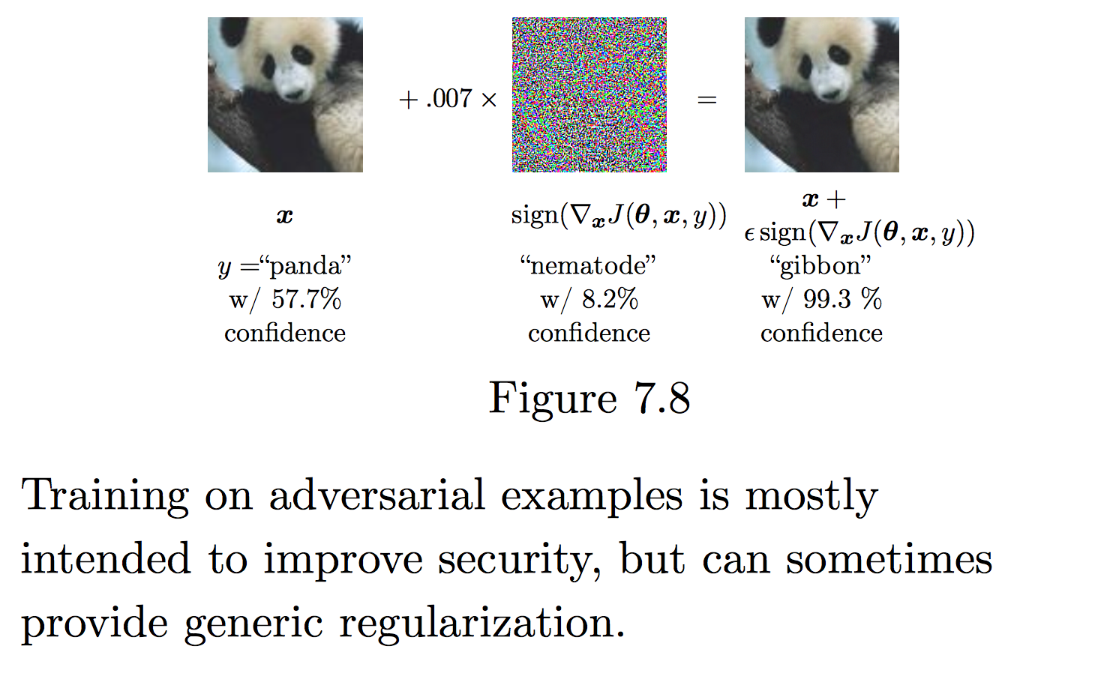
deeplearningbook.org

Slide 70
Multi-task Learning

Slide 71
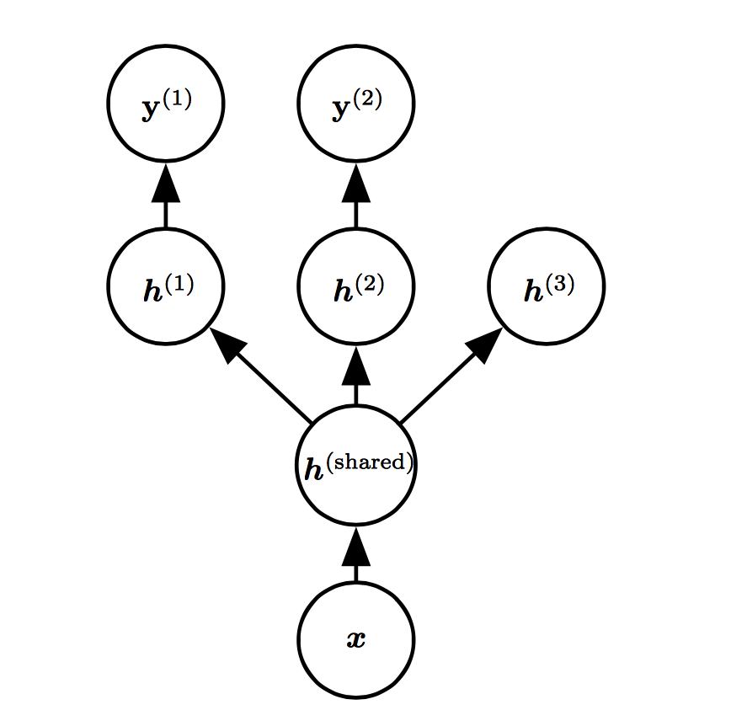
Goodfellow et al. (2016)

